Slide 1

BUSINESS ADMINISTRATION
SOFTWARE
ALA-TOO INTERNATIONAL UNIVERSITY
Spring Semester 2025-2026

Slide 2
***
Mistakes are the portals of discovery
— James Joyce

Slide 3
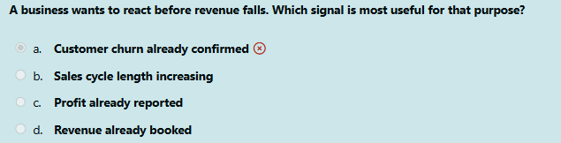
MOST COMMON MISTAKES THE QUESTION

Slide 4
EARLY WARNING SIGNAL WHY “SALES CYCLE LENGTH INCREASING” IS CORRECT
If deal time grows from 10 days to 20 days, the business should treat it as a warning sign and investigate immediately.
A business wants to react before revenue falls, so it must watch a signal that shows trouble early. Sales cycle length increasing is useful because it means deals are taking longer to close. This can show that customers are hesitating, approvals are slower, or the sales process is becoming weaker. This is important because it gives managers time to act before the fall in revenue appears in the reports. Sales cycle length increasing is the best answer because it helps the business see danger early and respond before revenue drops

Slide 5
EARLY WARNING SIGNAL WHY “SALES CYCLE LENGTH INCREASING” IS CORRECT
The other options are weaker because they show results after the problem already happened:
Customer churn already confirmed → the customer is already lost
Profit already reported → this is a late result
Revenue already booked → this shows past performance, not future risk

Slide 6
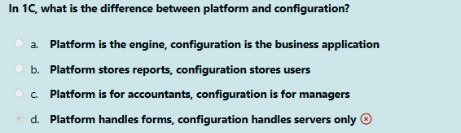
MOST COMMON MISTAKES THE QUESTION

Slide 7
PLATFORM VS CONFIGURATION ENGINE VS BUSINESS APP
In 1C the platform is the technical foundation. It is the system that lets developers develop, debug and run 1C applications. The official 1C documentation describes the platform as the environment that contains everything needed to create and run applications. The configuration is the actual business application built on that platform. In 1C’s own materials, a configuration is described as a finished application that contains the objects, rules, and code needed for business work such as accounting, ERP, sales, inventory or HR.

Slide 8
WHY CHOSEN OPTION IS CORRECT REAL TECHNICAL DIFFERENCE
Platform = engine
Configuration = business solution
a. Platform is the engine, configuration is the business application
This is correct because it matches the official structure of 1C. The platform is the universal runtime and development base, while the configuration is the applied solution created for a business purpose

Slide 9
WHY THE OTHER OPTIONS ARE WRONG INVALID CHOICES EXPLAINED
b. Platform stores reports, configuration stores users
This is not the real difference. The platform is not just a place for reports, and the configuration is not just a place for users. A configuration defines data, data processing, forms, printouts, and business logic. It is much broader than “users,” while the platform provides the technological support for all of this.

Slide 10
WHY THE OTHER OPTIONS ARE WRONG INVALID CHOICES EXPLAINED
c. Platform is for accountants, configuration is for managers
This is wrong because platform and configuration are not divided by job role. The platform is the technical environment, and the configuration is the application logic. Both can be used by many different business roles depending on the solution.

Slide 11
WHY THE OTHER OPTIONS ARE WRONG INVALID CHOICES EXPLAINED
d. Platform handles forms, configuration handles servers only
This is also wrong. The configuration is not “servers only.” In 1C, configuration includes business objects such as catalogs, documents, registers, forms, and processing logic. The platform supports and runs these elements, but the configuration defines the business structure itself.

Slide 12
ANALOGY CAR AND DRIVER PURPOSE
Platform = the car engine, frame, and core system
Configuration = the specific car built for a purpose, like taxi, ambulance, or delivery van
The engine makes the vehicle work.
The final design decides what job it performs.
In the same way, the platform makes 1C run, while the configuration decides what business task it solves. This matches 1C’s explanation that the platform provides the environment and the configuration defines the application behavior and data structure

Slide 13
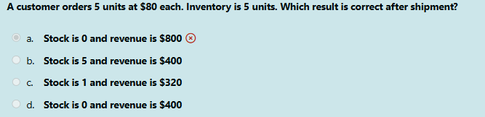
MOST COMMON MISTAKES THE QUESTION

Slide 14
SHIPMENT RESULT WHY “STOCK IS 0 AND REVENUE IS $400” IS CORRECT
A customer orders 5 units at $80 per unit.
The inventory available is also 5 units.
This means the business has exactly enough stock to fulfill the order completely.
After shipment, two things must happen in the system:
First, inventory must decrease because the physical goods left the warehouse.
The company had 5 units and shipped 5 units, so the remaining stock becomes:
5 - 5 = 0

Slide 15
SHIPMENT RESULT WHY “STOCK IS 0 AND REVENUE IS $400” IS CORRECT
Second, revenue must reflect the value of what was sold.
The customer bought 5 units, and each unit costs $80, so total revenue is:
5 × 80 = $400
So the correct result is:
Stock is 0 and revenue is $400
This answer is correct because it updates both sides properly:
the physical side of the business: stock goes down
the financial side of the business: revenue goes up
That is exactly how a business system should behave after a completed shipment.

Slide 16
SHIPMENT RESULT WHY THIS MATTERS IN BUSINESS
This question is not really about arithmetic. It is about understanding how a business transaction affects different parts of the system at the same time.
One customer shipment creates multiple business effects:
inventory is reduced
the sale value is recorded
the transaction becomes part of operational and financial reporting
A good business software system must update these connected results correctly. If even one part is wrong, the company may get false stock data, false sales figures, or bad management decisions. That is why this answer is important: it shows correct thinking across both inventory control and sales accounting.

Slide 17
SHIPMENT RESULT ANALOGY
Imagine a small electronics shop has 5 keyboards on the shelf. Each keyboard costs $80. A customer comes in and buys all 5 keyboards. What happens next?
the shelf becomes empty
the shop earns $400
the system should now show 0 keyboards left
It would make no sense to say:
the shop still has 5 keyboards, or
the shop earned $800, or
only part of the stock was removed
The sale must match reality.So this question is really.

Slide 18
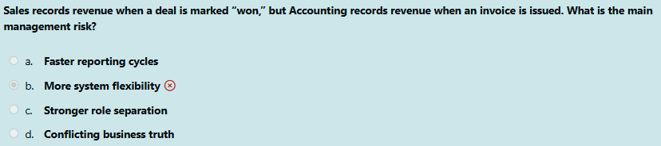
MOST COMMON MISTAKES THE QUESTION

Slide 19
CONFLICTING BUSINESS TRUTH WHY THIS IS THE CORRECT ANSWER
Sales records revenue when a deal is marked won. Accounting records revenue when an invoice is issued. At first this may look like a small difference in timing. In reality, it creates a much bigger management problem. The problem is that the company now has two different answers to the same question:
“When should this revenue be treated as real?”
Sales says one thing.
Accounting says another.
This means the business no longer has one shared truth. Instead, it has competing versions of reality depending on which department or system a manager looks at. That is why the best answer is "conflicting business truth"

Slide 20
CONFLICTING BUSINESS TRUTH WHAT MAKES THIS DANGEROUS
One department says : “The deal is real when the customer agrees.”
Another department says : “No, the deal becomes real only when the invoice is issued.”
Both are talking about the same sale, but they are not using the same business rule. So the company has not just a reporting difference. It has a definition problem. And when a company has different definitions for the same event, managers start seeing different versions of the business. That is exactly what is meant by conflicting business truth.

Slide 21
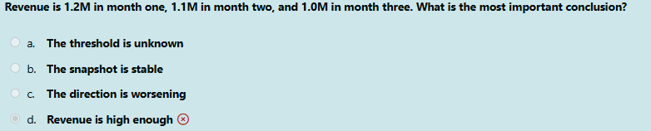
MOST COMMON MISTAKES THE QUESTION

Slide 22
TREND DIRECTION WHY “THE DIRECTION IS WORSENING” IS CORRECT
The revenue values are:
Month 1 = 1.2M
Month 2 = 1.1M
Month 3 = 1.0M
Each month, revenue goes down. So even though the numbers may still look large, the important thing is that the business is not moving upward or staying flat. It is moving downward month after month.
That means the most important conclusion is not about the absolute size of revenue. It is about the trend. The trend shows deterioration.
That is why the best answer is c.) The direction is worsening

Slide 23
TREND DIRECTION WHAT THIS QUESTION IS REALLY TESTING
This question is checking whether students can distinguish between:
looking at one number by itself
and looking at the direction of performance over time
Managers do not only ask: “Is revenue big?”
They also ask:“Is revenue improving, staying flat, or getting worse?”
Here, the pattern is clear: 1.2 → 1.1 → 1.0 (tthat is a decline)
So the key idea is this:
A business can still have “large” revenue and still be moving in the wrong direction.

Slide 24
TREND DIRECTION ANALOGY
Imagine a student gets these marks:
85
78
70
Those marks are not all terrible. But the teacher should immediately notice the pattern: the student is going down each time.
The main conclusion is not, “70 is still not zero”
The main conclusion is “performance is dropping”
This revenue question works in the same way.
The numbers may still look respectable, but the direction is clearly negative.

Slide 25
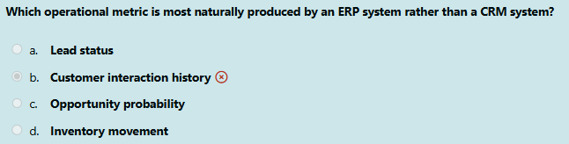
MOST COMMON MISTAKES THE QUESTION

Slide 26
ERP OR CRM WHY
This question is really asking:
Which metric comes naturally from the system that runs internal business operations?
The answer is inventory movement because inventory belongs to the operational side of the business. When stock:
enters the warehouse
moves from one location to another
is reserved for an order
is shipped to a customer
is adjusted after a count
the system that usually records this is ERP

Slide 27
ERP OR CRM WHY
Because ERP is designed to manage the company’s internal resources and process flow:
inventory
purchasing
warehouse operations
production
orders
finance
So inventory movement is a natural ERP output because it reflects what is physically happening inside the business.
That is why the correct answer is: d. Inventory movement

Slide 28
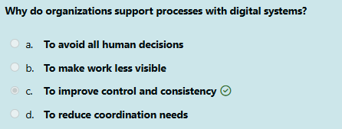
INTERESTING IDEA THE QUESTION

Slide 29
DIGITAL PROCESS SUPPORT WHY “TO IMPROVE CONTROL AND CONSISTENCY” IS CORRECT
Organizations use digital systems to support processes because business work must be carried out in a repeatable, visible, and controlled way.
When a process is handled only manually, different people may do the same task in different ways:
one employee may skip a step
another may enter data differently
another may forget approval rules
another may delay the handoff
Very quickly, the process becomes inconsistent.

Slide 30
DIGITAL PROCESS SUPPORT WHY “TO IMPROVE CONTROL AND CONSISTENCY” IS CORRECT
Digital systems help solve this problem by making the work more structured. They help the organization apply the same logic, the same sequence, and the same rules again and again.
That is why the best answer is: to improve control and consistency
The word control matters because managers want to know that work is happening according to the required process. The word consistency matters because the same business action should not produce different results just because different people handled it. So digital systems are not there only to make work faster. They are there to make work more reliable and more manageable.

Slide 31
DIGITAL PROCESS SUPPORT ANALOGY
Imagine a restaurant kitchen. If every cook decides to prepare the same dish in a completely different way, the restaurant has a problem. One plate is too salty, another is late, another is missing ingredients. Customers will not trust the restaurant. Now imagine the kitchen uses a standard recipe and a clear order system. Each cook still works, but the work is guided by the same process. That is what digital systems do in organizations. They do not remove all human work.
They make sure human work happens inside a more controlled and consistent structure.

